Slide 1

Web scraping PROJECT to gain company insights and real world experience in analysis sentiments
Platform – Jupyter Notebooks

Slide 2
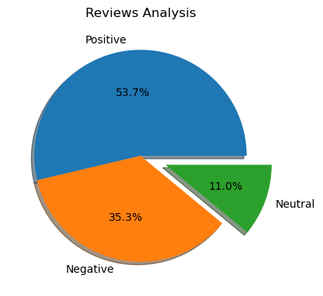
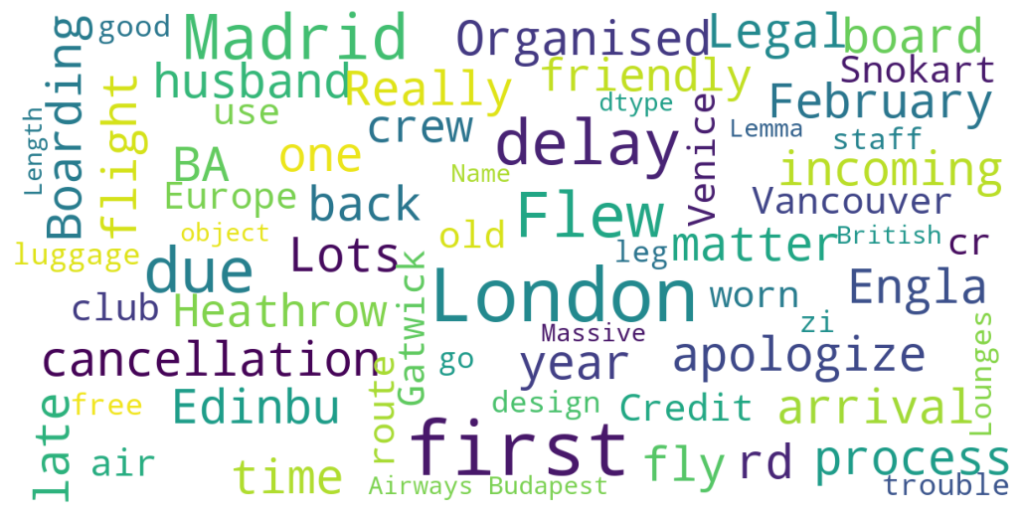
As a result of our data analysis, we obtained the following –
Positive reviews – 53.7%
Negative reviews – 35.3%
Neutral reviews – 11%
Here is the word cloud for keywords from the reviews given data

